Slide 1

Department: Computer Science and Engineering
Program: Bachelor of Computer Science and Engineering
Course Title: Project with Seminar
Course Code: CSE-432
Presentation on
“A Web-Based Programming Learning Management System, for Empowering Programming Education Globally”
Supervised By:
Dr. Kingkar Prosad Ghosh
Associate Professor and Head of the Department, Dept. of CSE
R. P. Shaha University
Presented By:
Mithi Akter
ID: 19100004
Dept. of CSE
R. P. Shaha University
NARAYANGANJ 2023

Slide 2
ABSTRACT
This presentation is about a web-based programming learning management system that provides a user-friendly platform for teachers and students to create, manage, and deliver online courses and so many programming learning facilities.
This system has three panels: admin, teacher, and student. The system also includes programming learning insightful articles, contents with online compiler for the all the users. So, it can be said that, the system can be a useful asset for all programmers for learning and teaching programming.

Slide 3
INDEX
Abstract
Introduction
Objectives
Programming language(s)/platform
Related Works
Methodology
The architecture of the project (Use-Case Diagram, Activity Diagram)
Main Feature of the project.
Result / Output of the project
Importance & limitations of the project.
Conclusion
Questions / Answers

Slide 4

INTRODUCTION
This project is designed to provide a platform for teacher to teach & students to learn programming languages and practicing their code.
The system is built using modern technologies and it has three panels: admin, teacher, and student. Where-
Admins have access to all system features and can manage users, courses, and contents.
Teachers can create and manage courses, assign quizzes and assignments, and view student progress.
Students can explore courses by category, search courses with keywords, and enroll courses. The system also includes an online compiler, video content, quiz system, assignment system, and student-teacher messaging and so on.

Slide 5

The objective of this project is to provide an accessible, simple, and user-friendly learning platform for students and teachers who want to learn and teach programming languages and improve their skills.
The project also aims to smooth the process of delivering and managing virtual education by enable teachers to deliver study materials to students synchronously by ensuring the security and privacy of student data and course materials.
By achieving these objectives, this project desires to become a bridge between the gap education and technology
OBJECTIVES

Slide 6




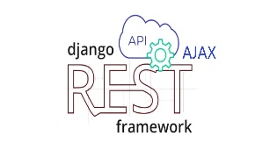



PROGRAMMING LANGUAGE(S)/PLATFORM
Python
HTML
Django
PROJECT
CSS
Django REST Framework
React
MySQL
GitHub

Slide 7



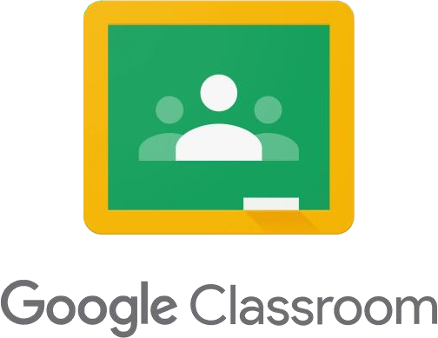


RELATED WORKS

Slide 8

HELLO & WELCOME
TO PRESENTATION
WELCOME MESSAGE
Presentations are communication tools that can be used as demonstrations, lectures, speeches, reports, and more. It is mostly presented before an audience.
LETS GET STARTED

Slide 9



HOW TO USE THIS
PRESENTATION
GOOGLE SLIDES
POWERPOINT
CANVA
Click on the "Google Slides" button below this presentation preview. Click on "Make a copy." Start editing your presentation. You need to sign in to your Google account.
Click on the "PowerPoint" button below this presentation preview.
Start editing your presentation.
Download and install the fonts used in this presentation as listed on page 21.
Click on the "Canva" button under this presentation preview. Start editing your presentation. You need to sign in to your Canva account.

Slide 10

DOWNLOAD THIS PRESENTATION AS A POWERPOINT TEMPLATE IN 3 STEPS
1.
Click on the "Canva" button next to this presentation. Start editing your presentation. You may need to sign in to your Canva account.
2.
Click on the "Share" button on the top right corner in Canva and click on "More" at the bottom of the menu.
3.
Enter "PowerPoint" in the search bar and click on the PowerPoint icon to download.

Slide 11
DOWNLOAD THIS PRESENTATION AS A GOOGLE SLIDE TEMPLATE IN 3 STEPS
1.
Click on the "Canva" button next to this presentation. Start editing your presentation. You may need to sign in to your Canva account.
2.
Click on the "Share" button on the top right corner in Canva and click on "More" at the bottom of the menu.
3.
Enter "Google Drive" in the search bar and click on the Google Drive icon to add this design as a Google slide in your G Drive. It will ask you to link your Google account to Canva the first time.

Slide 12
Table 1 | Table 2 | Table 3
42 | 49 | 74
89 | 166 | 196
275 | 395 | 397
402 | 427 | 487
654 | 876 | 895
INFOGRAPHIC
SLIDE REPORT
Presentations are communication tools that can be used as demonstrations, lectures, speeches, reports, and more. It is mostly presented before an audience.

Slide 13
INFOGRAPHIC slide report
Presentations are communication tools.
Presentations are communication tools that can be used as demonstrations.
$200
Monthly plan
Presentations are communication tools that can be used as demonstrations.
$400
Monthly plan
Presentations are communication tools that can be used as demonstrations.
$800
Monthly plan
Presentations are communication tools that can be used as demonstrations.
$1200
Monthly plan

Slide 14

INFOGRAPHIC
SLIDE REPORT
Series 3
Series 4
400
300
200
100
0
0
10
20
30

Slide 15


INFOGRAPHIC slide report
Presentations are communication tools.
EXAMPLE
EXAMPLE
Presentations are communication tools that can be used as demonstrations.
Presentations are communication tools that can be used as demonstrations.

Slide 16

INFOGRAPHIC slide report
Presentations are communication tools.
Series 1
Series 2

Slide 17
Series 1
Series 2
Series 3
INFOGRAPHIC
SLIDE REPORT
Presentations are communication tools that can be used as demonstrations.
EXAMPLE
Presentations are communication tools that can be used as demonstrations.
EXAMPLE
Presentations are communication tools that can be used as demonstrations.

Slide 18
INFOGRAPHIC slide report
Presentations are communication tools.
EXAMPLE
EXAMPLE
EXAMPLE
25
40
50
20
30
40
15
30
20
10
20
5
10
10
0
Item 1
Item 2
Item 3
Item 4
Item 5
0
Item 1
Item 2
Item 3
Item 4
Item 5
0
Item 1
Item 2
Item 3
Item 4
Item 5

Slide 19

INFOGRAPHIC
SLIDE REPORT
Presentations are communication tools that can be used as demonstrations.
EXAMPLE
EXAMPLE

Slide 20
INFOGRAPHIC slide report
Presentations are communication tools.
Table 1 | Table 2 | Table 3
42 | 49 | 74
89 | 166 | 196
275 | 395 | 397
402 | 427 | 487
654 | 876 | 895
Table 1 | Table 2 | Table 3
45 | 43 | 76
32 | 166 | 543
453 | 542 | 432
432 | 427 | 678
654 | 876 | 765
2022
2023

Slide 21
125
CREDITS
100
This presentation template
is for everyone to use thanks
to the following:
75
50
SlidesCarnival for the presentation template
Pexels for the photos
25
HAPPY DESIGNING!
0
Item 1
Item 2
Item 3
Item 4
Item 5

Slide 22







































ICONS
RESOURCE PAGE
Use these design resources in your Canva Presentation. Happy designing!
Don't forget to delete this page before presenting.

Slide 23
OUTPUT OF THE PROJECT

Slide 24
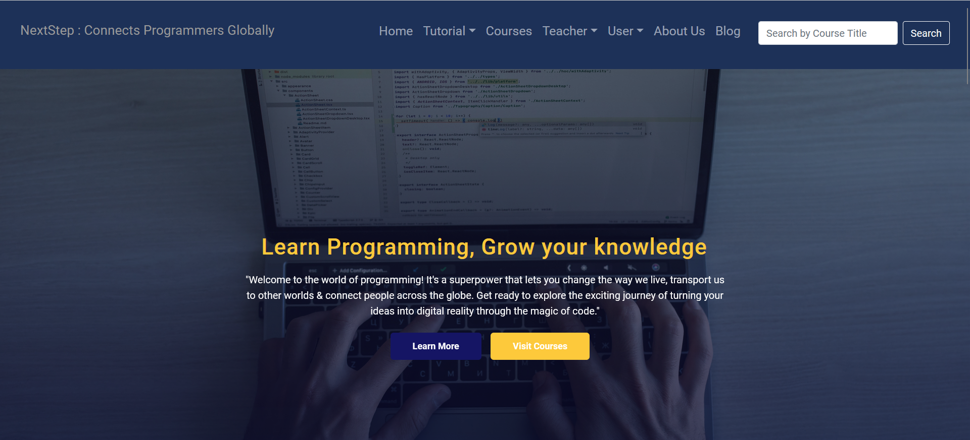
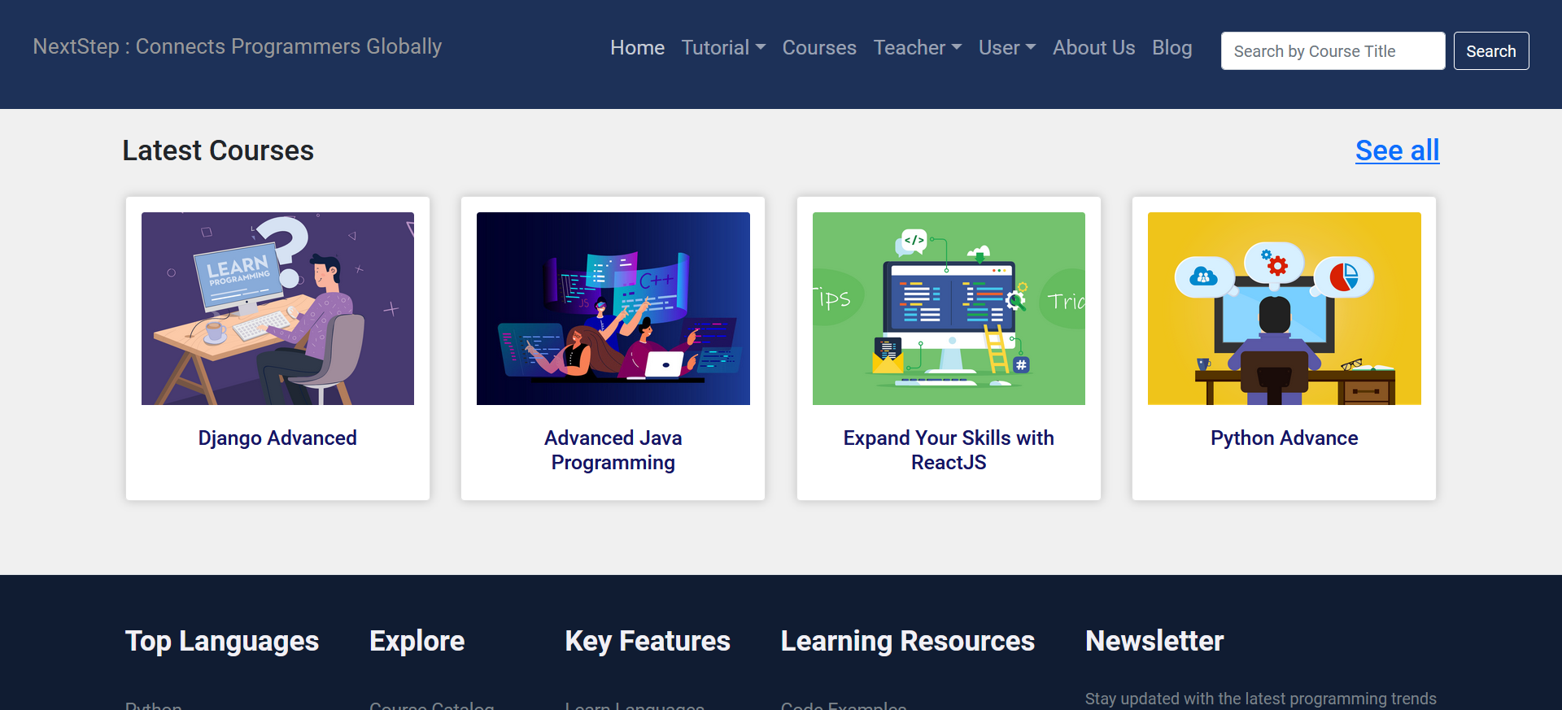
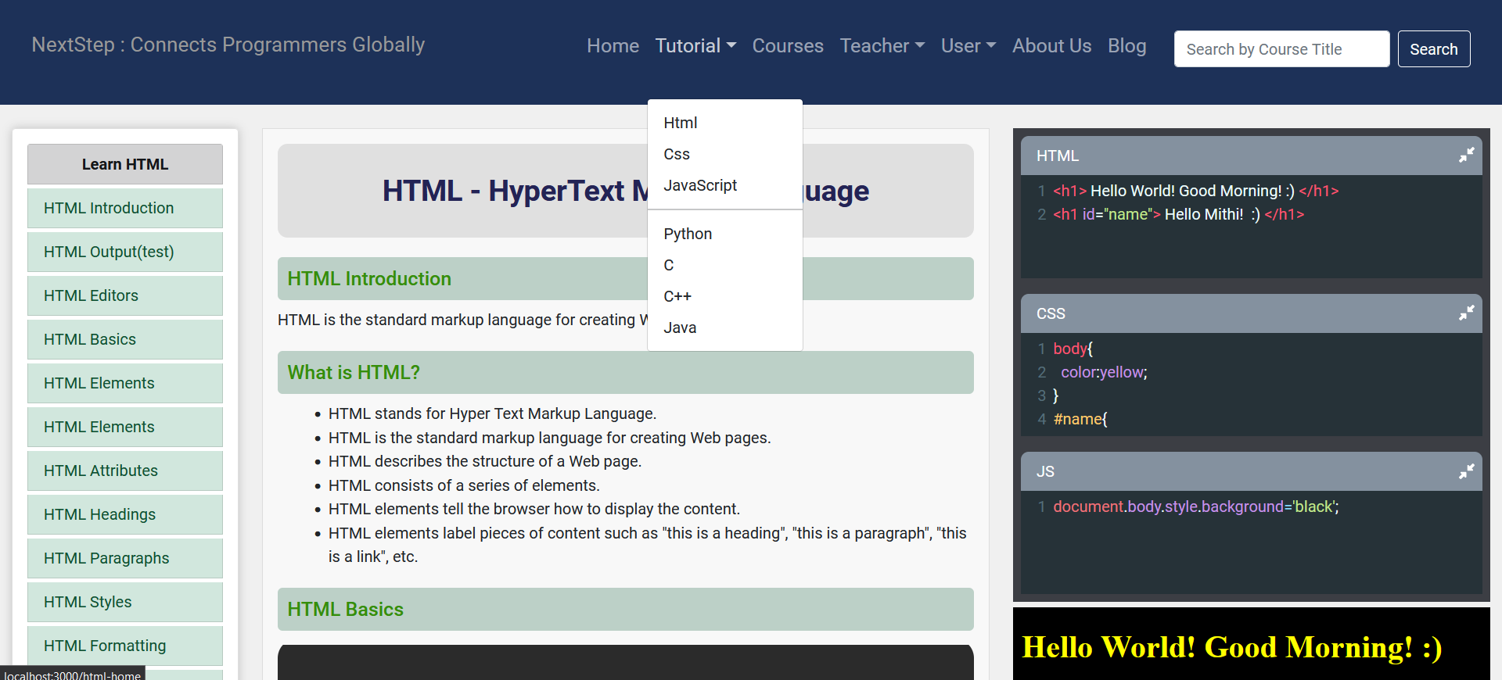
Landing Page
Home Page
Tutorial Page

Slide 25
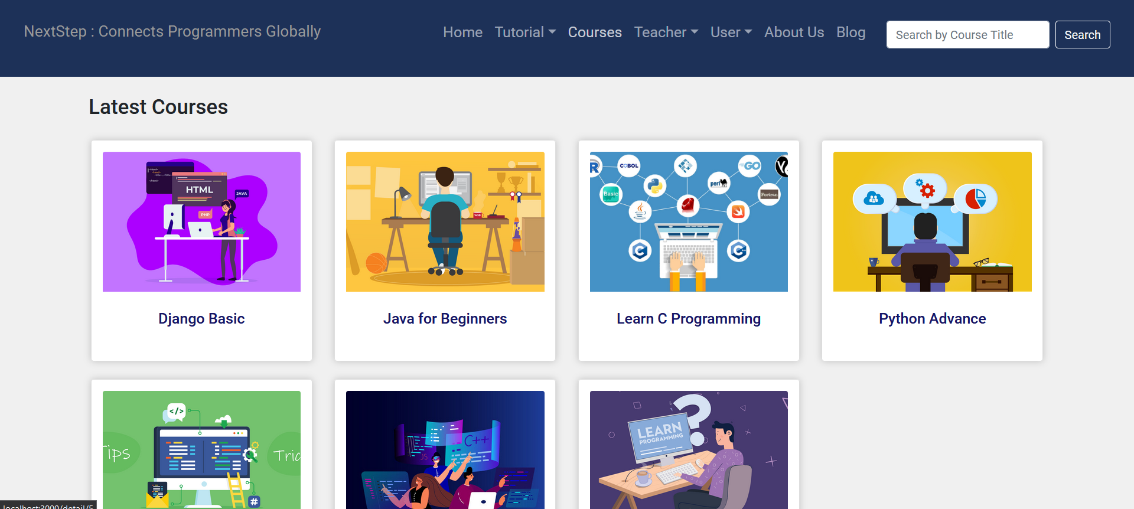
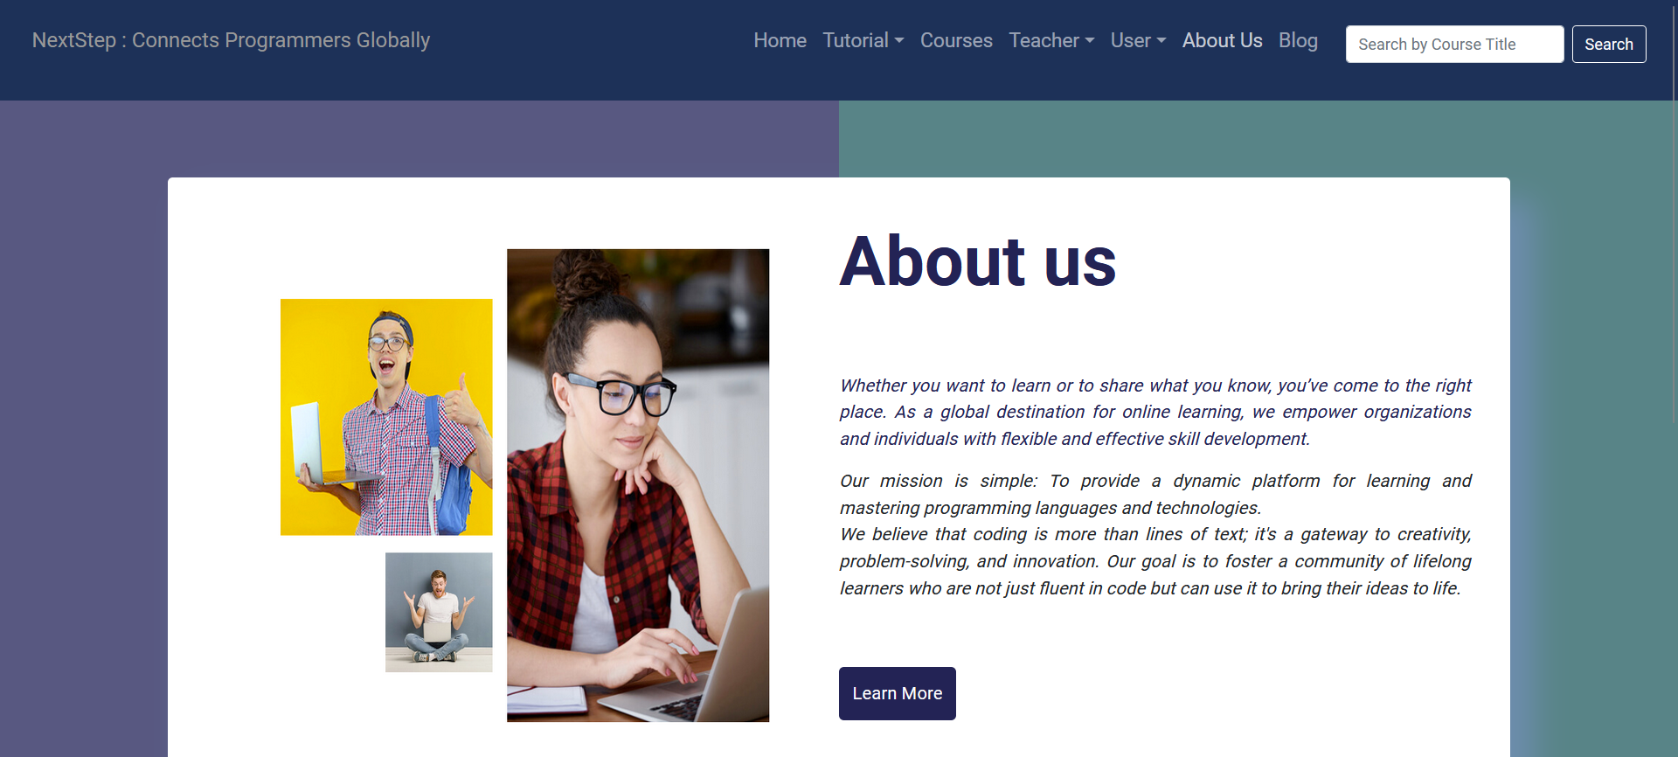
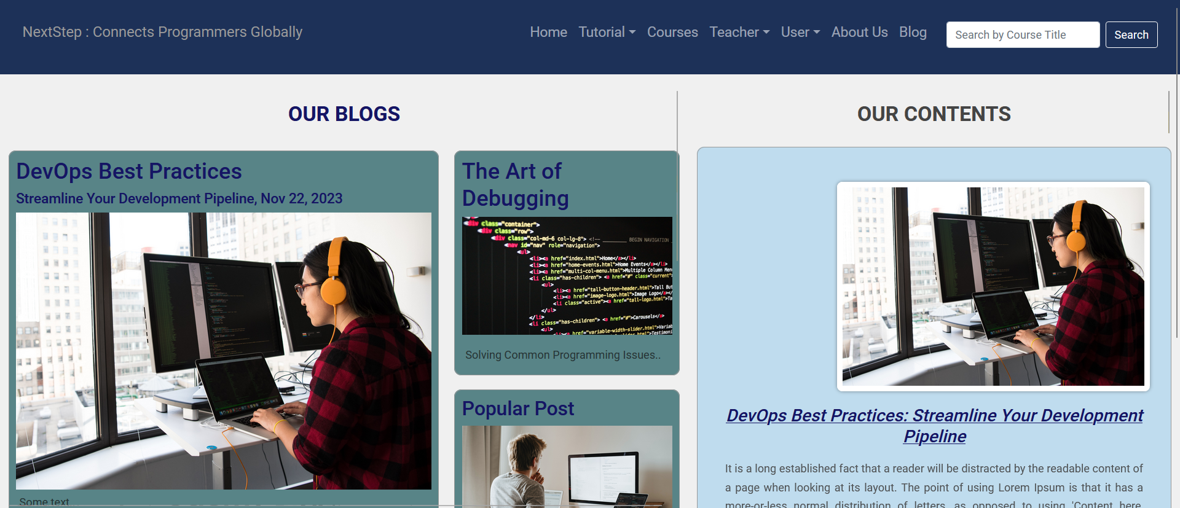
Courses Page
About Us Page
Blog Page

Slide 26
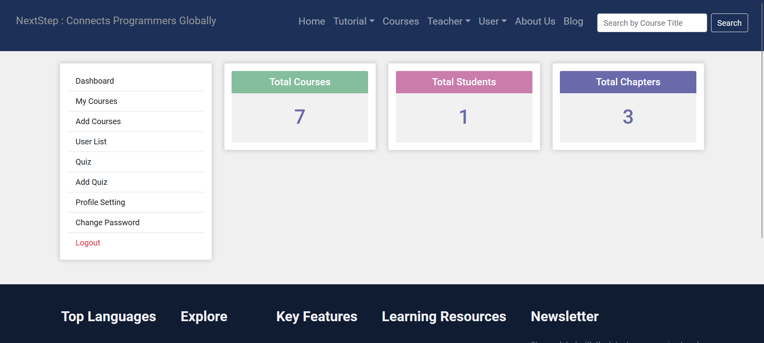
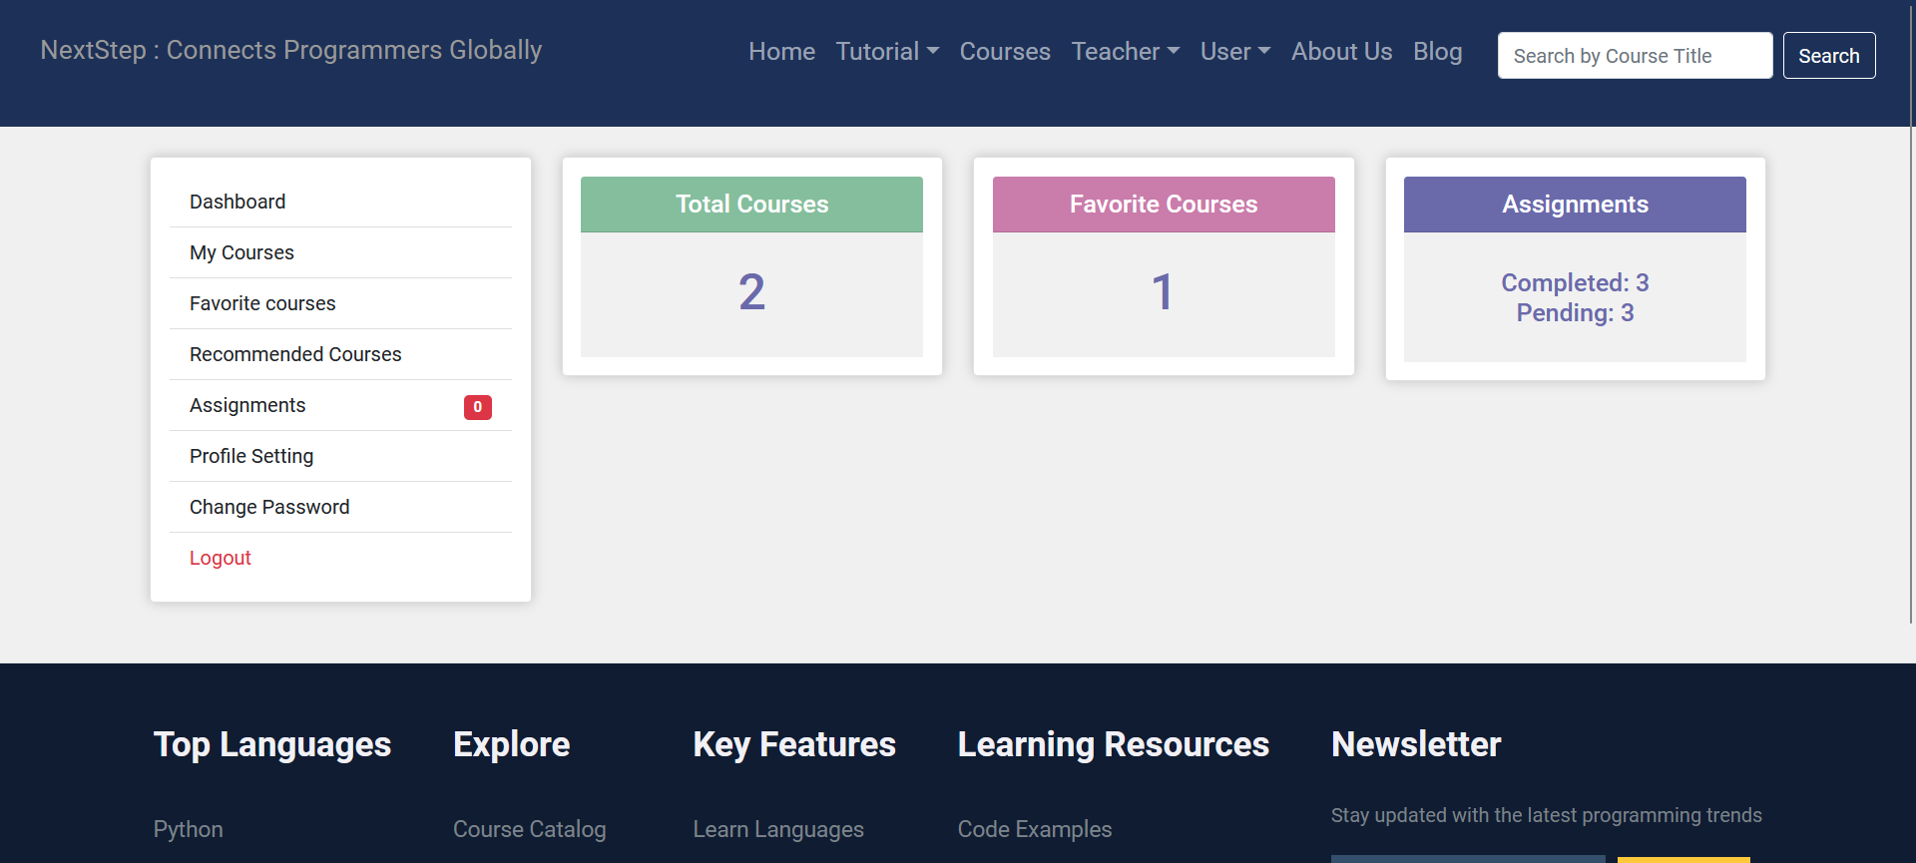
Teacher Dashboard Page
Student Dashboard Page

Slide 27
This project has numerous importance like-
Comprehensive Admin Controls
Accessible Learning
Efficient Course Management
Future-Ready Technology
Flexible Enrollment
Engaging Content
Interactive Practice
Flexibility
IMPORTANCE OF THE PROJECT

Slide 28
Some limitations of this project are-
A large number of users can lead to server overload and slow response times.
Duplication of content can be challenging, potentially leading to confusion among users.
Large volumes of content and multimedia elements can result in slow page loading times, causing user frustration.
Students may try to cheat on their assignments and exams by using online tools.
Manual Payment Processing.
LIMITATIONS OF THE PROJECT

Slide 29
This programming learning management system has been developed to be convenient, user-friendly, and affordable with offering some features that are free to use.
With this system, students can learn programming and teacher can teach at their own pace and on their own time, without breaking the bank.
Finally, this system is comprehensive, covering a wide range of programming languages and topics.
CONCLUSION

Slide 30
In conclusion, the programming learning management system has been developed to be convenient, user-friendly, and affordable, offering some features that are free to use.
With this system, students can learn programming, and teachers can do so at their own pace and on their own time, without breaking the bank.
Finally, this system is comprehensive, covering a wide range of programming languages and topics.
CONCLUSION

Slide 31
Thank You..

Slide 32
Any Questions?

